Slide 1
Web Services

Slide 2
Information in this document is subject to change without notice. The example companies, organizations, products, people, and events depicted herein are fictitious. No association with any real company, organization, product, person or event is intended or should be inferred. Complying with all applicable copyright laws is the responsibility of the user.
Microsoft may have patents, patent applications, trademarked, copyrights, or other intellectual property rights covering subject matter in this document. Except as expressly provided in any license agreement from Microsoft, the furnishing of this document does not give you any license to these patents, trademarks, or other intellectual property.
© 2011 Microsoft Corporation. All rights reserved.
Microsoft, MS, Windows, MSDN, Visual Basic, Visual C++, Visual C#, and Visual Studio are either registered trademarks or trademarks of Microsoft Corporation in the U.S.A. and/or other countries.
Other product and company names herein may be the trademarks of their respective owners.
Microsoft Biology Initiative Training by Microsoft Corporation is licensed under a Creative Commons Attribution 3.0 Unported License. Based on a work at research.microsoft.com/bio.

Slide 3
Agenda
.NET Web Services
WebRequest/Response
WCF
.NET Bio Web Services Architecture
IServiceHandler
Build in web service support
BLAST
ClustalW
Calling services asynchronously
threading architecture
BackgroundWorker
Building custom service wrappers

Slide 4
Web Services
Web Services enable loosely coupled extensions to applications
communication between client and server driven by contracts
client and server can exist anywhere
key ingredient to building enterprise systems
Web Service standards defined by W3C
members include IBM, Microsoft, Oracle, etc.
parties agree to conform to defined standards
Standards define how parties communicate
both payload and metadata transfer supported
security, transactions, binary data, etc. all defined by standards

Slide 5
It all starts with HTTP
Hypertext Transport Protocol (HTTP)
standardized data protocol of the WWW
text based protocol on top of TCP protocol stack
supports header, control codes, verbs
message oriented stream based request/response
client always instigates conversation
security supported through transport encryption (TLS)
System.Net namespace contains .NET network support
classes for managing HTTP request/response streams
Simple Object Access Protocol (SOAP)
XML document for remote object method invocations

Slide 6
System.Net.WebRequest
System.Net.WebRequest
HTTP/S specific implementation created by factory method
uses WebResponse class to manage returning stream
can be invoked synchronously or asynchronously
performs all the standard HTTP work necessary
WebRequest request = WebRequest.Create("https://www.microsoft.com");
WebResponse response = request.GetResponse();
using (Stream stream = response.GetResponseStream())
using (StreamReader reader = new StreamReader(stream))
{
Console.WriteLine( reader.ReadToEnd() );
}
this code requests the data located at https://www.microsoft.com, in this case, HTML would be returned and printed out to the console

Slide 7
Going beyond raw HTTP
Windows Communication Foundation (WCF) supplies higher level constructs for web communication
supplied as part of .NET 3.0 and beyond
build or invoke SOAP or REST based services
also supports binary transfers (.NET only)
implements variety of WS-* standards
communicates using contracts (typically .NET interfaces)
<?xml version="1.0"?>
<soap:Envelope>
<soap:Body xmlns:m="http://www.example.org/stock">
<m:GetStockPrice>
<m:StockName>MSFT</m:StockName>
</m:GetStockPrice>
</soap:Body>
</soap:Envelope>
Client (.NET)
Server (Java, .NET, C++, etc.)
HTTP(S) communication

Slide 8
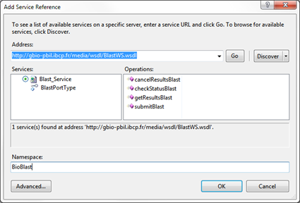

Web service clients with WCF
"Add Service Reference" or svcutil.exe creates proxy
creates contract-based proxy code in language of choice
creates address + binding data in app.config
driven from WSDL or WS-Metadata
C:\>svcutil http://gbio-pbil.ibcp.fr/media/wsdl/BlastWS.wsdl /config:app.config /out:generatedProxy.cs

Slide 9
Using WCF client proxy
void ProcessSequence(ISequence sequence)
{
using (var client = new BlastPortTypeClient())
{
string results = client.submitBlast(sequence.ToString());
Console.WriteLine( results );
}
}
proxy allows typical method call invocation just like any other component
<configuration>
<system.serviceModel>
<client>
<endpoint address="http://gbio.ibcp.fr:8090/Blast_Service"
binding="basicHttpBinding"
contract="BioBlast.BlastPortType" />
</client>
</system.serviceModel>
</configuration>
configuration defines location and communication style for service

Slide 10
Service support in .NET Bio
.NET Bio defines a simplified web service architecture
based on WebRequest – WCF not required^{[1]}
contained in Bio.Web namespace, core support part of Bio.dll
defines name, description and configuration for calling services
each specific web service type extends this interface
.NET Bio provides two specific web service types
BLAST – Bio.Web.Blast.IBlastServiceHandler
ClustalW – Bio.Web.ClustalW.IClustalWServiceHandler
Notes:
[1] Note that this does not preclude a biologist using .NET Bio with WCF to invoke a known SOAP or REST based web service independent of the .NET Bio service support.

Slide 11
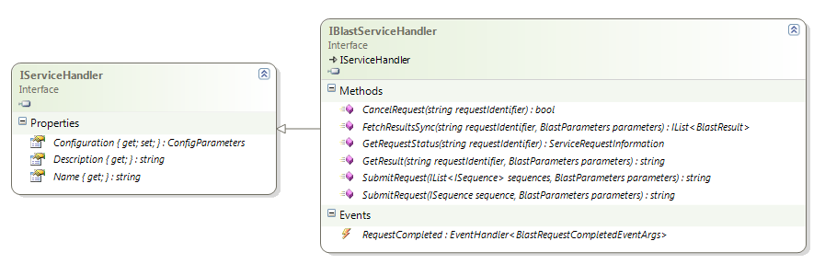
BLAST services
BLAST provides algorithm for comparing sequences
allows researchers to identify sequences that resemble query
input is typical a set of sequence(s)
output varies – HTML, plain text, or XML (used for services)
defined by IBlastWebServiceHandler

Slide 12
BLAST service implementations
Several implementations of BLAST available online
NCBI BLAST (http://blast.ncbi.nlm.nih.gov/Blast.cgi)
EBI WU-BLAST (http://www.ebi.ac.uk/Tools/webservices/services/wublast)
Windows Azure reference implementation
.NET Bio implements concrete support in extension DLL
Bio.WebServiceHandlers.dll
Can use types directly, or locate them dynamically
Bio.Web.WebServices static class provides accessors
foreach (IBlastServiceHandler handler in WebServices.All) {
… }

Slide 13
Invoking BLAST services with .NET Bio
NCBIBlastHandler class supports calling NCBI BLAST service
included in Bio.WebServiceHandlers assembly
can be called synchronously or asynchronously (preferred)
takes input sequence(s) and returns IList<BlastResult>
ISequence sequence = ...;
IBlastServiceHandler ncbi = WebServices.NcbiBlast;
if (ncbi != null) {
BlastParameters bp = GetBlastParameters();
string jobKey = ncbi.SubmitRequest(sequence, bp);
IList<BlastResult> results = ncbi.FetchResultsSync(jobKey, bp);
ProcessResults(results); }
be aware that each call can throw Exceptions to report errors

Slide 14
Blast Parameters
BLAST services take parameters to control processing
algorithm to run (blastn, blastp, blastx, etc.)
database to work against (Database)
threshold for reporting matches (Expect)
…
Defined per-service, but lots of commonality
read specific docs for service being invoked for proper values
BlastParameters GetBlastParameters() {
var bp = new BlastParameters();
bp.Add("Program", "blastn");
bp.Add("Database", "nr");
bp.Add("Expect", "10.0");
return bp; }
parameters stored as string to string values in dictionary – passed to service as part of the query string used to invoke the service

Slide 15
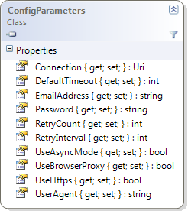
Locating the services
Default configuration for services is generally appropriate
can be changed using IServiceHandler.ConfigParameters
var blastService = WebServices.NcbiBlast;
blastService.Configuration = new ConfigParameters
{
UseBrowserProxy = true,
DefaultTimeout = 5,
Connection = new Uri("http://...")
};
Connection property defines URI used to invoke the specific service – can be changed to call a compatible service in a different location (geo based, or even locally hosted)
Notes:
Note: DefaultTimeout is in MINUTES

Slide 16
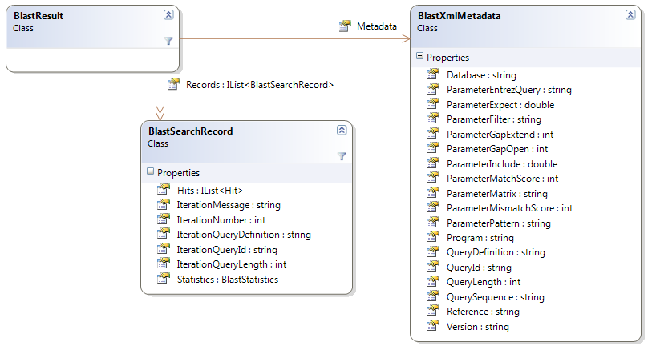
Processing Results
Results are reported as BlastResult objects
one per submitted sequence
search records define "hits" and statistics obtained by searching the database

Slide 17
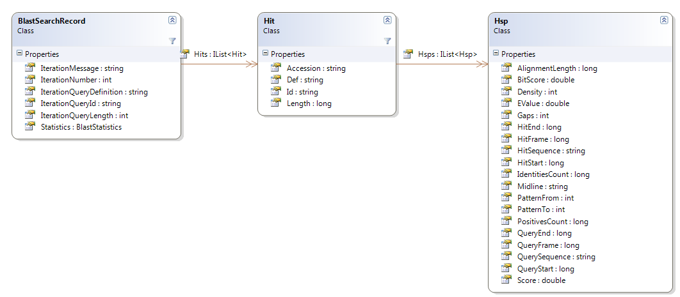
BlastSearchRecord
Each BlastResult has one or more search records
defines hits located in database, along with statistics
each Hit includes "high-scoring segment pair" (Hsps) for aligned matches

Slide 18
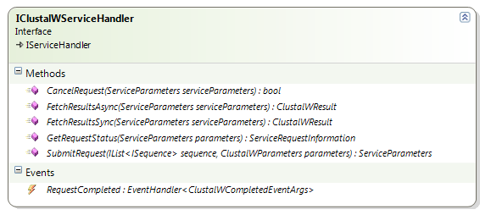
Other service types
.NET Bio also defines multi-alignment web service handler
defined by Bio.Web.IClustalWServiceHandler
no implementation currently supplied
Same basic pattern as BLAST service
create service proxy
set parameters and configuration
submit request
harvest results

Slide 19
Efficiently processing results
BLAST and ClustalW services are not fast
lots of processing and searching in fairly large databases
not really efficient to wait on the service
ideally continue working and process results when available
Async programming solves this problem
keeps programs responsive – users hate hanging UIs
takes advantage of today's CPU architectures (multi-cores)
.NET has direct support for asynchronous programming
directly creating threads – using System.Threading.Thread
finite work using System.ComponentModel.BackgroundWorker
Framework supports two patterns for async execution
IAsyncResult-based asynchronous pattern
event-based asynchronous pattern

Slide 20
IAsyncResult based pattern
.NET Framework use common async pattern in many classes
BeginXXX initiates operation and returns state object
EndXXX harvests results (including exceptions) using state object
state object provides access to running async operation
often models synchronous method XXX
public class WebRequest
{
public WebResponse GetResponse();
public IAsyncResult BeginGetResponse(...);
public WebResponse EndGetResponse(IAsyncResult ar);
}
GetResponse broken into two calls – BeginGetResponse starts call and EndGetResponse returns final result, but it's done asynchronously now

Slide 21
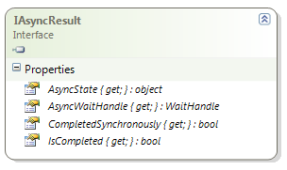
Managing asynchronous operation
IAsyncResult returned from BeginXXX call
used to tie specific BeginXXX and EndXXX calls together
properties of interface provide current status of the running operation – primarily whether it has completed (IsCompleted) and results are ready
var request = WebRequest.Create("http://www.microsoft.com");
IAsyncResult ar = request.BeginGetResponse(null, null);
... can continue working here until we need results
WebResponse response = request.EndGetResponse(ar);
Begin/EndGetResponse must be executed on same WebRequest instance

Slide 22
Moving beyond polling
IAsyncResult.IsComplete can be used to poll operation state
easy, but not very efficient
much better to have system perform callback when complete
defined by AsyncCallback delegate parameter of BeginXXX
public class WebRequest
{
...
public IAsyncResult BeginGetResponse(AsyncCallback callback,
object asyncState);
}
asyncState property allows "state" object to be carried through operation – held in IAsyncResult.AsyncState property

Slide 23
Example: using a callback
WebRequest req = WebRequest.Create("http://....");
IAsyncResult ar = req.BeginGetResponse(RetrieveComplete, request);
Background Thread used to execute GetResponse
Thread
continues execution
void RetrieveComplete(IAsyncResult iar) {
WebRequest req = (WebRequest) iar.AsyncState;
WebResponse response = req.EndGetResponse(iar);
... }
callback method is invoked on background thread

Slide 24
Event-based programming pattern
.NET 2.0 introduced a simpler event-based pattern
component exposes completion event that code wires handler to
code initiates asynchronous activity
often allows code to cancel request
component raises event when operation is complete, passing results to code
This is the model used by web service proxies and .NET Bio
public interface IBlastServiceHandler : IServiceHandler
{
event EventHandler<RequestCompletedEventArgs> RequestCompleted;
string SubmitRequest(ISequence seq, BlastParameters bp);
bool CancelRequest(string requestIdentifier);
...
}

Slide 25
Example: Event based programming
string IssueBlastRequest(ISequence sequence)
{
IBlastServiceHandler ncbi = WebServices.NcbiBlast;
ncbi.RequestComplete += OnSearchCompleted;
BlastParameters bp = GetBlastParameters();
return ncbi.SubmitRequest(sequence, bp);
}
void OnSearchComplete(object sender, RequestCompletedEventArgs e) {
if (!e.IsCanceled && e.Error == null)
{
IList<BlastResults> results = e.SearchResult;
ProcessResults(results); } }

Slide 26
Dealing with failures
Both patterns capture exceptions that occur in the operation
exception can then be examined by client code
IAsyncResult pattern defers the exception
re-raised when you call EndXXX
Event-based pattern captures Exception
passes it to the completion method as part of EventArgs
make sure to always test for presence of Exception!
also need to check for cancelation

Slide 27
Thread synchronization
Threads are almost too easy to create in .NET
never forget that multiple threads always increases the complexity of the application!
Must synchronize access to shared data structures
most classes can be safely read by multiple threads
when you have writers modifying the data you must synch access
Callbacks invoked on background thread
this includes the event-based pattern!
.NET supports a full set of synchronization mechanisms
monitors, mutexes, semaphores, ...
Also, check out the new lock-free classes
CountdownEvent, SpinLock, SpinWait, SemaphoreSlim, etc.

Slide 28
Wrapping custom services
.NET Bio provides infrastructure to wrap existing services
or create new services and connect to them with .NET Bio
Examine BLAST implementation(s) in WebServiceHandlers
readable example code on wrapping known services
Five basic steps
define new IServiceHandler derived interface
define new EventArgs and results data structures
create handler implementation (in separate assembly)
mark type with [RegistrableAttribute(true)]
deploy assembly in Add-ins folder

Slide 29
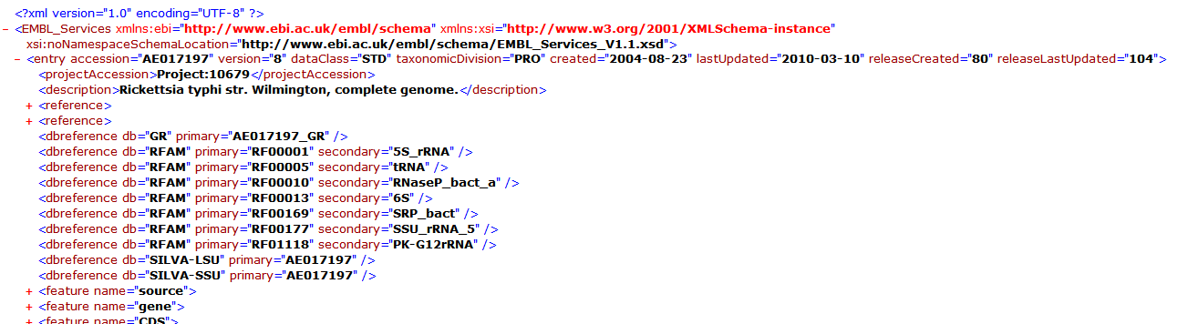
Example: EBI dbfetch
European Bioinformatics Institute (EBI) has online repository of sequence data – much like GenBank
supports accessing through REST and SOAP services
can return data in variety of formats – including XML
www.ebi.ac.uk/Tools/webservices/rest/dbfetch/{db}/{id}/{format}
input includes database to search, the key to locate, and the returning format

Slide 30
Step 1: IServiceHandler
Define new IServiceHandler derivation
can use IBlastServiceHandler & IClustalWServiceHandler as examples
defines event used for asynchronous results
public interface IEmblServiceHandler : IServiceHandler
{
event EventHandler<RequestCompletedEventArgs> RequestCompleted;
bool SubmitRequest(string id);
EmblResponse FetchResultsSync();
}
should define methods to submit request and fetch results; can also provide cancellation if service supports it

Slide 31
Step 2a: Results data structures
EmblResponse provide access to the returning data
should be specific to the service data coming back
public class EmblResponse
{
public string Key { get; set; }
public string Version { get; set; }
public DateTime LastUpdate { get; set; }
public string Description { get; set; }
public ISequence SequenceData { get; set; }
...
}
all of this information is in the returning XML data

Slide 32
Step 2b: EventArgs
Customized EventArgs provides returning data from event
should report cancelation, errors and the results data structure
public class RequestCompletedEventArgs : EventArgs
{
public EmblResponse Result { get; private set; }
public Exception Error { get; private set; }
public RequestCompletedEventArgs(EmblResponse result,
Exception error)
{
Result = result;
Error = error;
}
}

Slide 33
Step 3: provide implementation
Service should be implemented in separate class
can use WebRequest, WCF, or any other network class
should perform work asynchronously
partial class EmblServiceHandler : IEmblServiceHandler
{
public bool SubmitRequest(string id)
{
var webRequest = WebRequest.Create(
string.Format(EmblUri, id));
webRequest.BeginGetResponse(OnRequestCompleted,
Tuple.Create(id,webRequest));
return true;
}
...
}

Slide 34
Step 3: processing results
Async results should be processed and raise event
private void OnRequestCompleted(IAsyncResult ar)
{
var data = (Tuple<string, WebRequest>) ar.AsyncState;
EmblResponse response = new EmblResponse { Key = data.Item1 };
Exception exception = null;
WebResponse webResponse = data.Item2.EndGetResponse(ar);
using (var stm = webResponse.GetResponseStream())
{
.. process results fill in response
}
RaiseRequestCompletedEvent(new RequestCompletedEventArgs(
response, exception));
}

Slide 35
Step 3: synchronous access
Implementation should also provide some way to fetch results
some clients desire synchronous behavior – although inefficient it is simple and sometimes required
internal event Set when results received, Reset when a new operation starts
partial class EmblServiceHandler
{
private readonly ManualResetEvent _completedEvent =
new ManualResetEvent(true);
private EmblResponse _response;
public EmblResponse FetchResultsSync()
{
_completedEvent.WaitOne();
return _response;
}
}

Slide 36
Step 4: add-in deployment
Implementation placed in segregated assembly
deployed with application in add-ins directory
marked with [Registrable(true)] so it can be located
[Registrable(true)]
public class EmblServiceHandler : IEmblServiceHandler
{
...
}

Slide 37
Example: using new service
static void Main(string[] args)
{
IEmblServiceHandler handler = new EmblServiceHandler();
handler.RequestCompleted += handler_RequestCompleted;
if (handler.SubmitRequest("AE014292"))
{
Console.WriteLine("Waiting..");
Console.ReadLine();
}
}
static void handler_RequestCompleted(object sender, RequestCompletedEventArgs e)
{
if (e.Error != null)
Console.WriteLine(e.Error);
else
{
Console.WriteLine("{0}: v{1} {2} - {3}", e.Result.Key,
e.Result.Version, e.Result.Description, e.Result.LastUpdate);
Console.WriteLine(e.Result.SequenceData);
}
}

Slide 38
Summary
Bioinformatics is moving towards web-enabled services
exposing public databases through modern web technologies
.NET Bio supports consuming services in simple ways
BLAST out of the box
others easily added
Can take advantage of .NET technologies to consume data
WebRequest
WCF
Consider using asynchronous calls for performance
no blocking!

Slide 39
Disclaimer: This document is provided "as-is". Information and views expressed in this document, including URL and other Internet Web site references, may change without notice. You bear the risk of using it.
This document does not provide you with any legal rights to any intellectual property in any Microsoft product. You may copy and use this document for your internal, reference purposes.
© 2010 Microsoft Corporation. All rights reserved.
Microsoft, Visual Studio, and Windows are trademarks of the Microsoft group of companies. All other trademarks are property of their respective owners.

